Slide 1
13th Annual Meeting
November 9 - 10, 2022

Slide 2
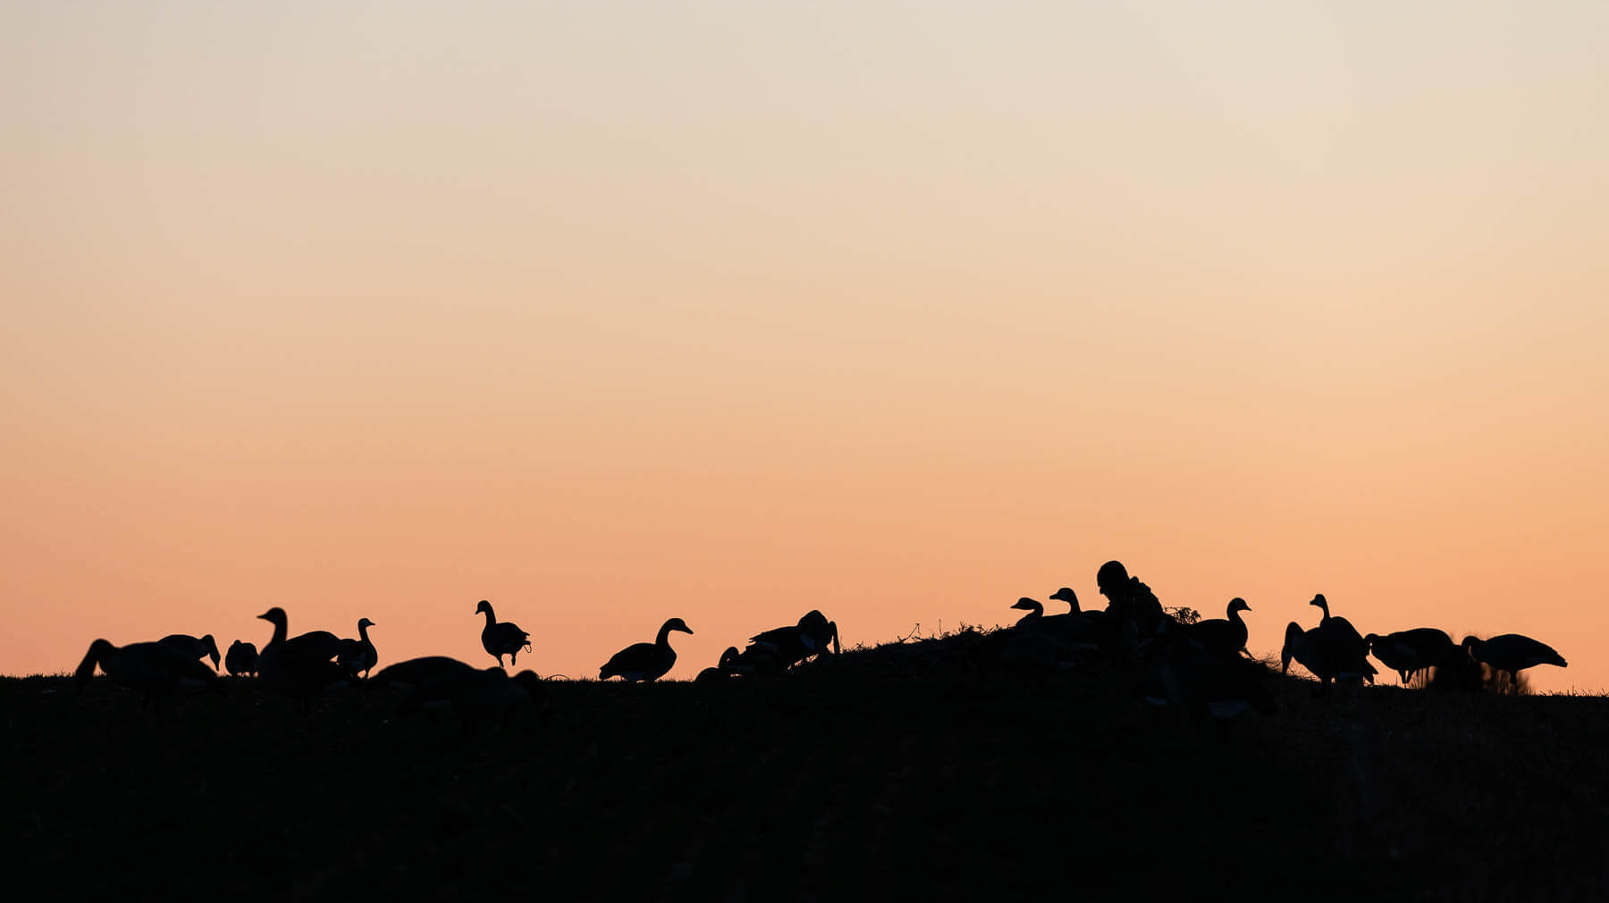
Chesapeake Conservation Partnership Co-Convenors
Wendy O’Sullivan, Superintendent, NPS Chesapeake Office
Joel Dunn, President and CEO, Chesapeake Conservancy

Slide 3
Speed dating
Find someone with the same animal
Sample Prompts
What are you most proud of that you’ve accomplished in the last year?
What do you most enjoy about your work?
What excites you about the future of conservation work?
What is the conservation challenge that you most want to tackle?
If you had a magic genie lamp with one wish, what is one thing you would wish for to help you meet your conservation goal?
What’s the oddest job you’ve ever had?

Slide 4
objectives
Energize our thinking with some inspiring examples from different landscapes.
Devise a common framework to provide a unified basis of collective action and support.
Spark state-level 30x30 strategies which will guide and inform our collective work.
Develop clear next steps

Slide 5
Agenda: Day ONe
11:00 | Welcome, Introductions, and Agenda Overview
Noon | Lunch
1:15 | Building a 30x30 Plan: Lessons from California
2:00 | Protecting and Conserving Land: Acquisitions and Strategies
2:30 | Break
2:50 | Building the Elements of a Collective 30x30 Approach for the Chesapeake
4:10 | Defending Conserved Land: The Threat of Data Centers and Energy Infrastructure
4:45 | Closing Reflections | Preview of Day 2
5:00 | Adjourn
7ish | Meet at the bar and the patio firepits . . .

Slide 6
Agenda: Day two
8:30 | Reflections, Agenda Review, and a Welcome
8:50 | Update on Chesapeake WILD
9:00 | Update on Protected Lands Database
9:20 | Meeting in State Teams
11:00 | Reports from State Teams | Creating the Game Plan
11:45 | Pulse Check and Instructions for the Afternoon
Noon | Lunch | Think about the Ideas
1:00 | Refining our Work | Action
2:15 | Next Steps
2:45 | Closing Thoughts
3:00 | Adjourn

Slide 7
Building a 30x30 Plan: Lessons from California
Jennifer Norris
Deputy Secretary for Biodiversity And Habitat, California Natural Resources Agency

Slide 8
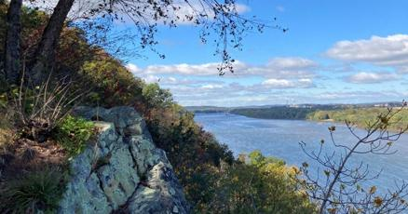
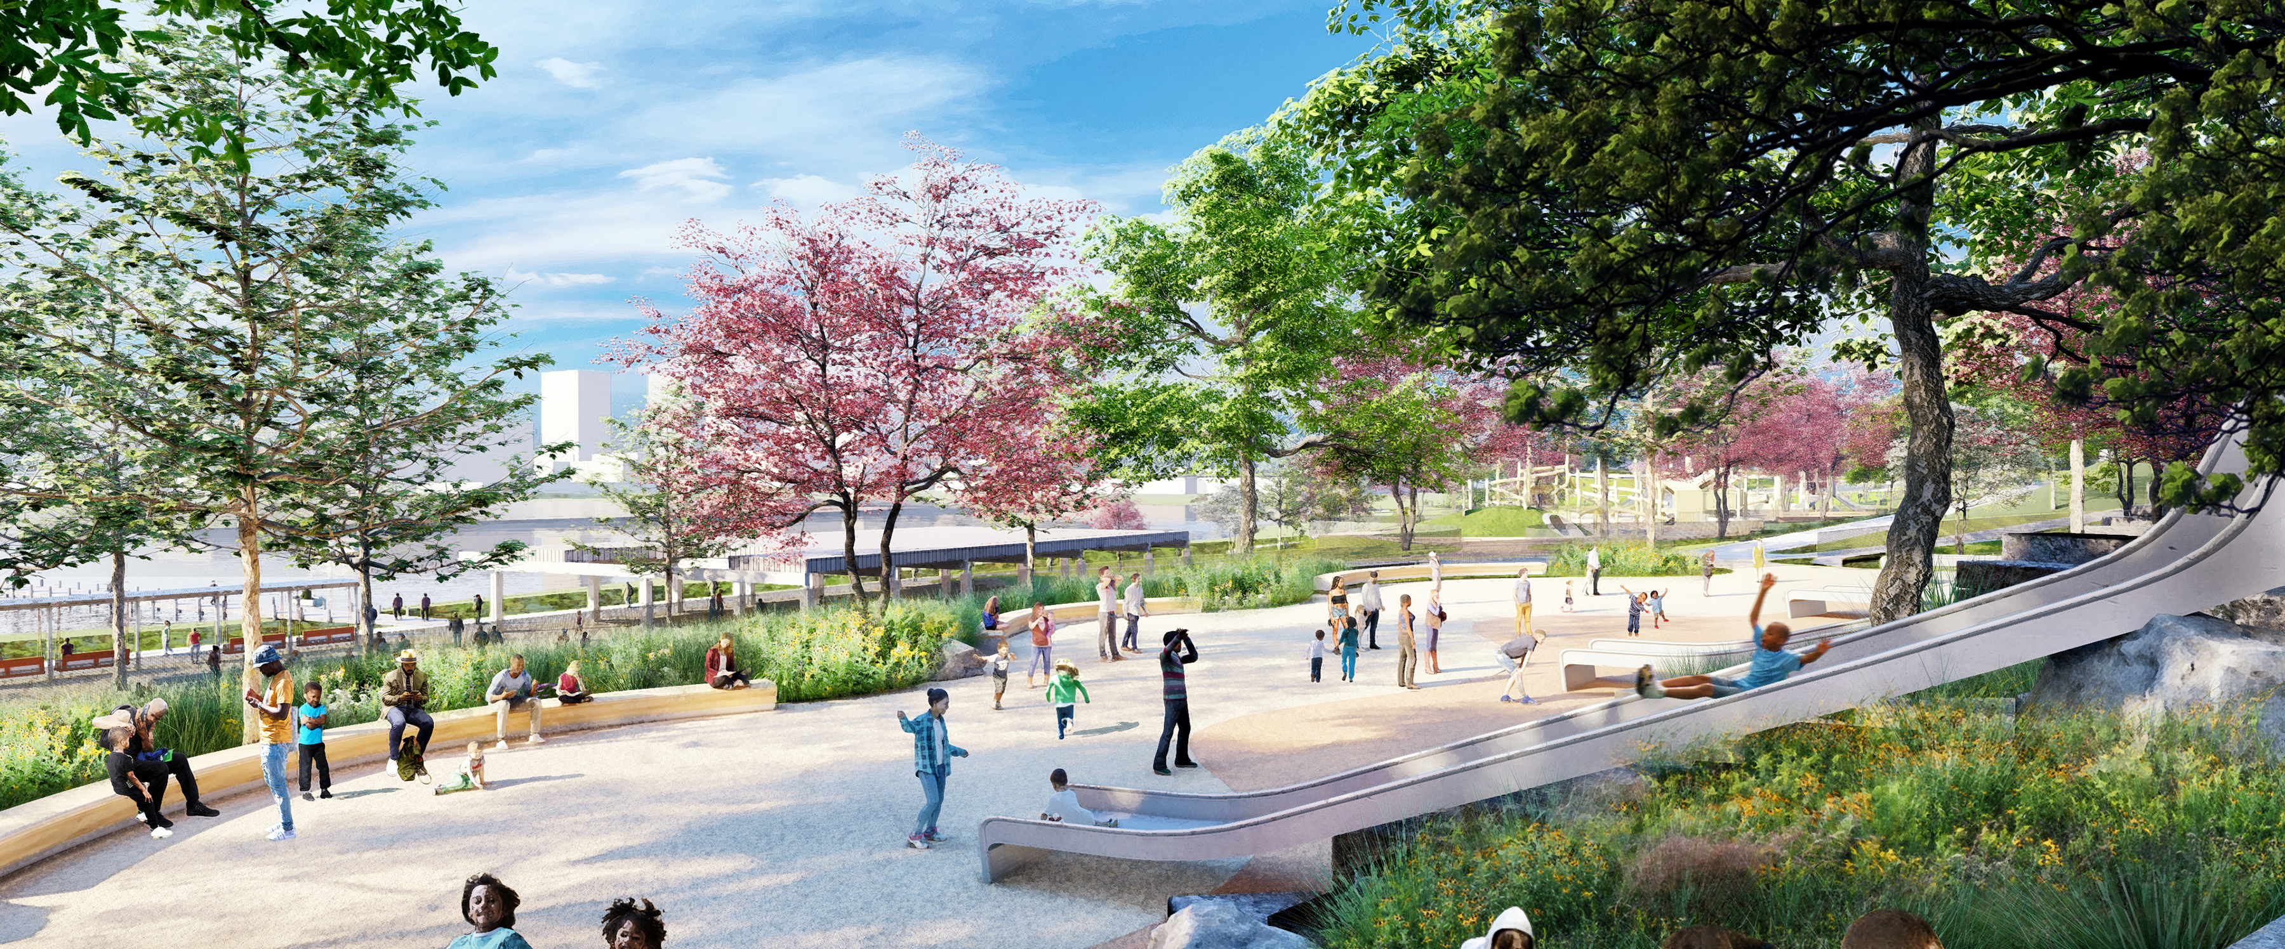
Protecting and Conserving Land: Acquisitions and Strategies
Brad Rogers, Executive Director of the South Baltimore Gateway Partnership
Phil Wenger, CEO of the Lancaster Conservancy

Slide 9
What are your takeaways from the California 30x30 plan presentation? Middle Branch? Susquehanna Riverlands? What might we think about for the Chesapeake watershed?

Slide 10
Agenda: Day two
8:30 | Reflections, Agenda Review, and a Welcome
8:50 | Update on Chesapeake WILD
9:00 | Update on Protected Lands Database
9:20 | Meeting in State Teams
11:00 | Reports from State Teams | Creating the Game Plan
11:45 | Pulse Check and Instructions for the Afternoon
Noon | Lunch | Think about the Ideas
1:00 | Refining our Work | Action
2:15 | Next Steps
2:45 | Closing Thoughts
3:00 | Adjourn

Slide 11
Update on Protected Lands Data 2022 – Chesapeake Bay Watershed
Renee Thompson, USGS, Chesapeake Bay Program
November 10, 2022
Chesapeake Conservation Partnership
Annual Meeting

Slide 12
https://www.chesapeakeprogress.com/conserved-lands/protected-lands
Notes:
Outcome Status summary

Slide 13
~1.5 million acres* have been protected since 2010 baseline
75% of our goal of 2 million acres
Our rate of land conservation has decreased
~150,000 acres on average per year between 2010 and 2018
~126,000 acres per year between 2010 – 2022
We will fall just short of our goal reaching ~95% at the current rate

Slide 14
Progress Toward 2 million Acre Goal
Protected Lands Summary
Year | 2010 | 2011 | 2013 | 2015_16 | 2018 | 2022
Watershed-Wide Cumulative Total Acres of Protected Land | 7,800,000 | 8,013,132 | 8,409,076 | 8,804,577 | 9,158,456 | 9,317,709
Total Acres toward goal | N/A | 213,132 | 609,076 | 1,004,577 | 1,358,456 | 1,517,709
Lands Preserved (percent of goal achieved) | N/A | 10.66% | 30.45% | 50.23% | 67.92% | 75.89%
~482,000 acres are needed to reach 2025 2-million-acre goal.
~76% of our goal has been met

Slide 15
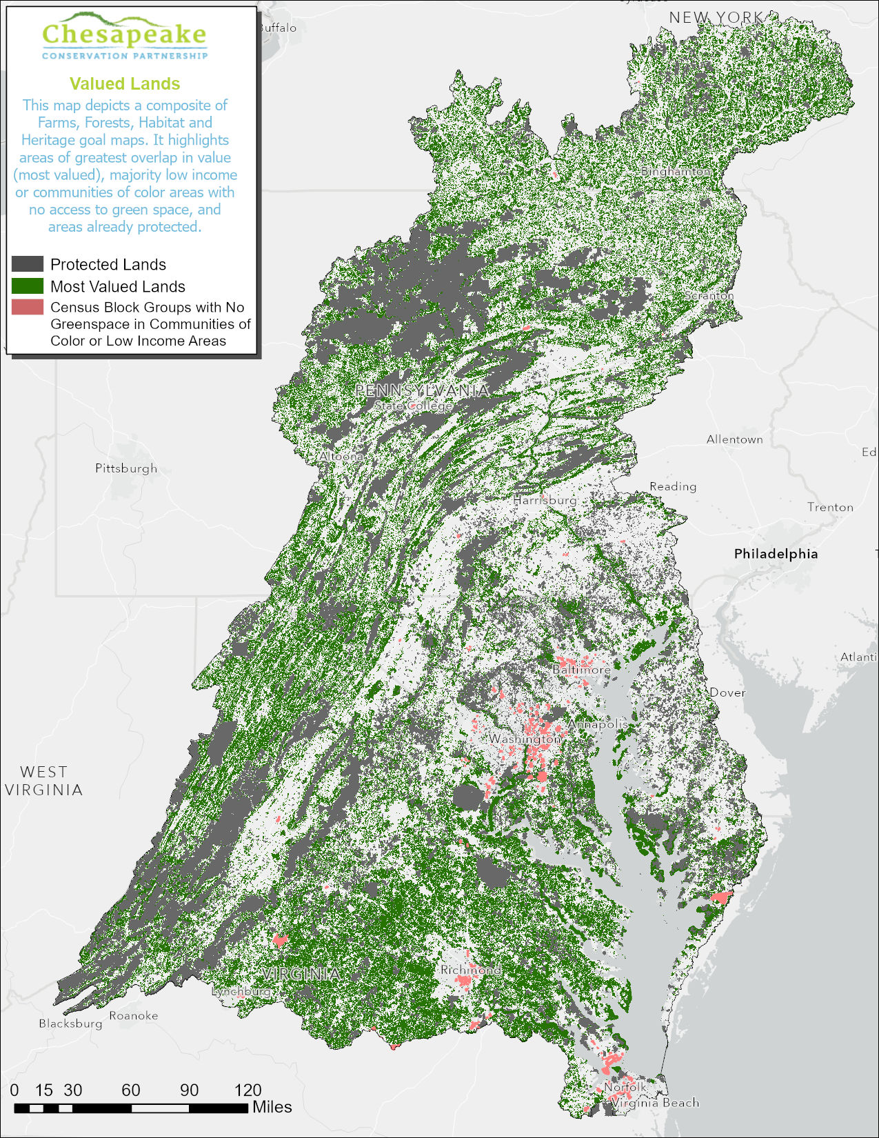
Chesapeake bay watershed CCP high value lands
Notes:
Note the GSE mapper can be modified to adjust the values for various census demographics of interest. This map represents Census block groups that are %80 low income OR %80 people of color AND no open access green space.
MOST VALUED CCP LANDS WITH PROTECTED LANDS AND UNDERSERVED AREAS WITH NO GREENSPACE

Slide 16
Notes:
Changes in federal lands DOD and other. Add acres. 133K (designation or proclamation boundaries that were previously included and are now excluded).

Slide 18
Delaware Progress toward 2-million-acre goal

Slide 19
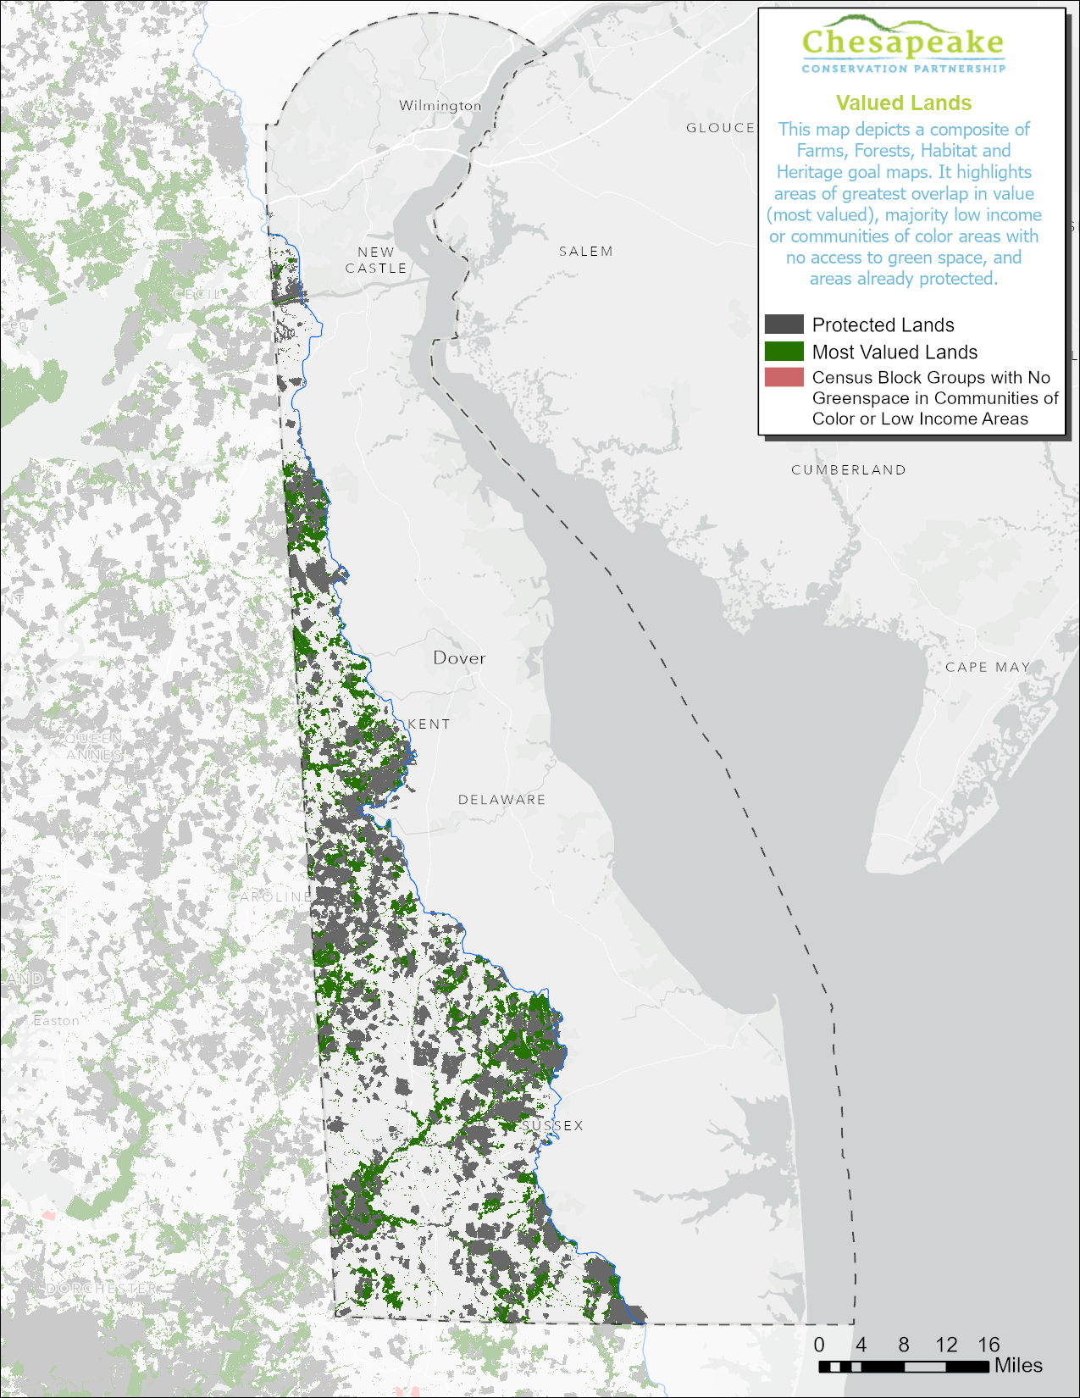
Delaware
Notes:
2020 2 class composite

Slide 20
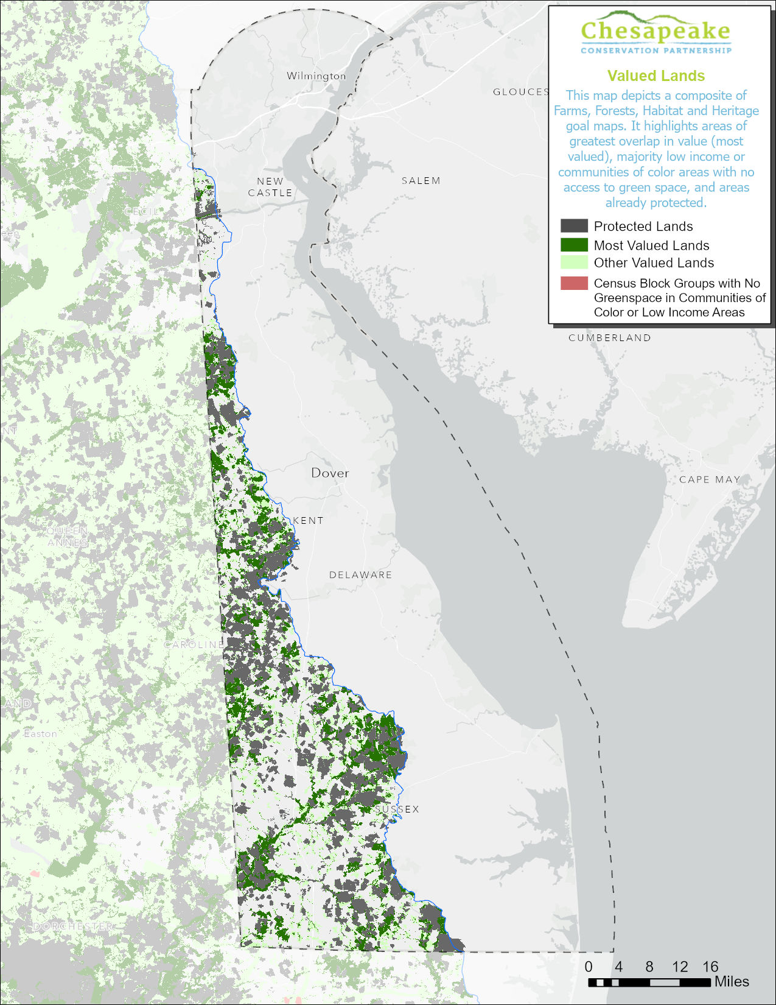
Delaware
Notes:
2020 1 class composite

Slide 21
Washington, D.C. Progress toward 2-million-acre goal

Slide 22
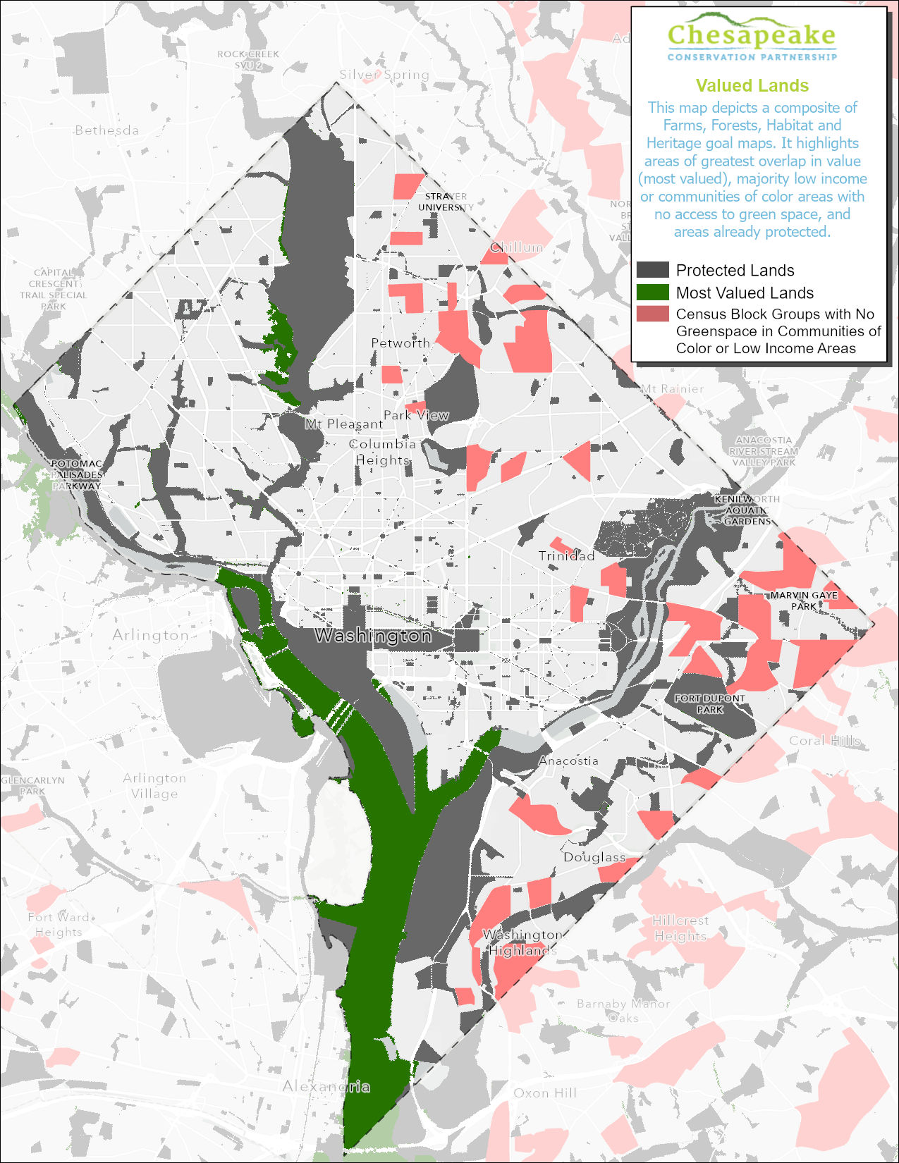
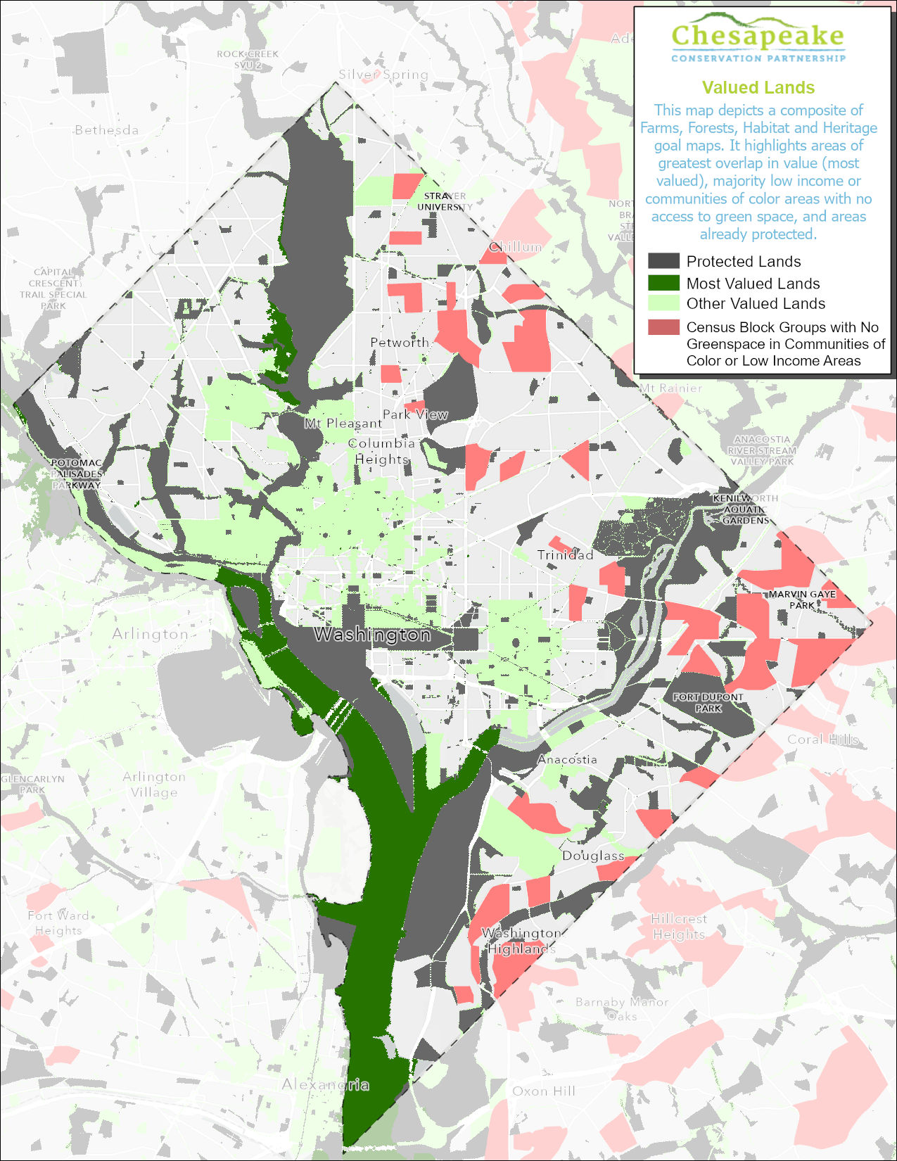
Washington, D.C.

Slide 23
Maryland Progress toward 2-million-acre goal

Slide 24
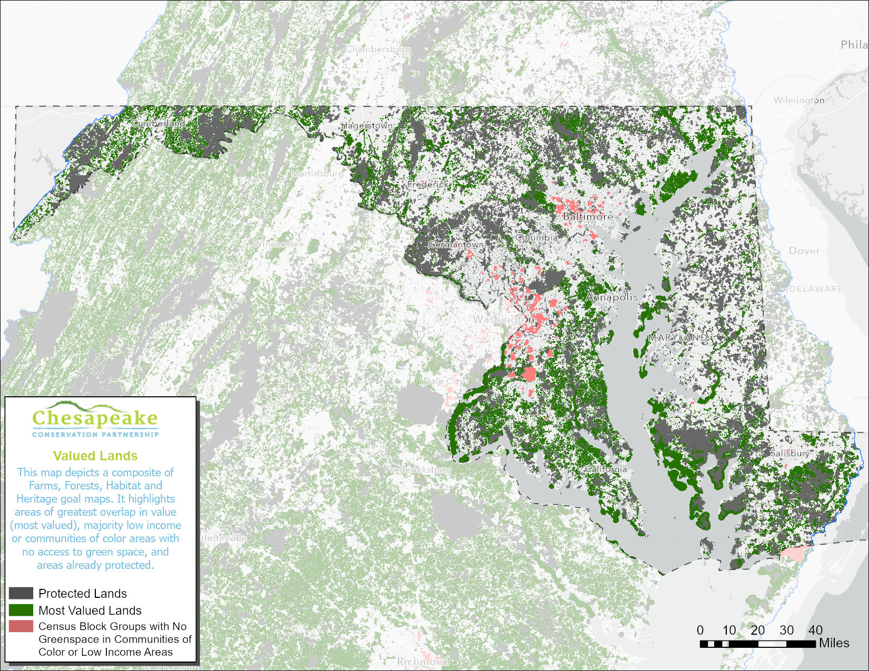
Maryland

Slide 25
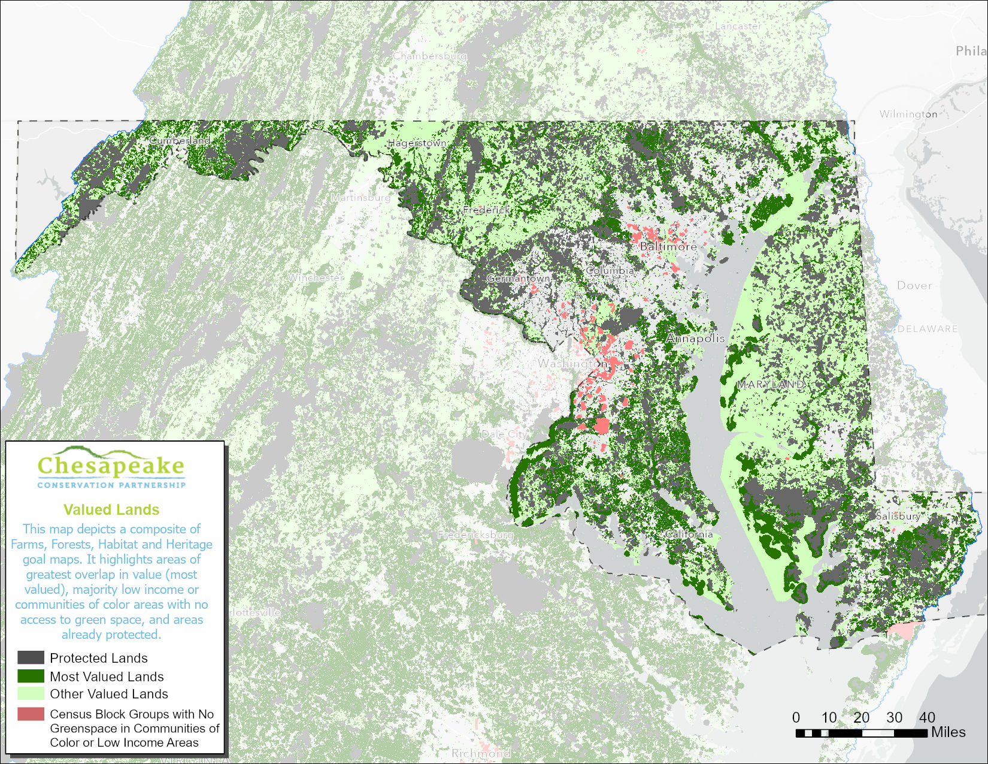
Maryland

Slide 26
New York Progress toward 2-million-acre goal

Slide 27
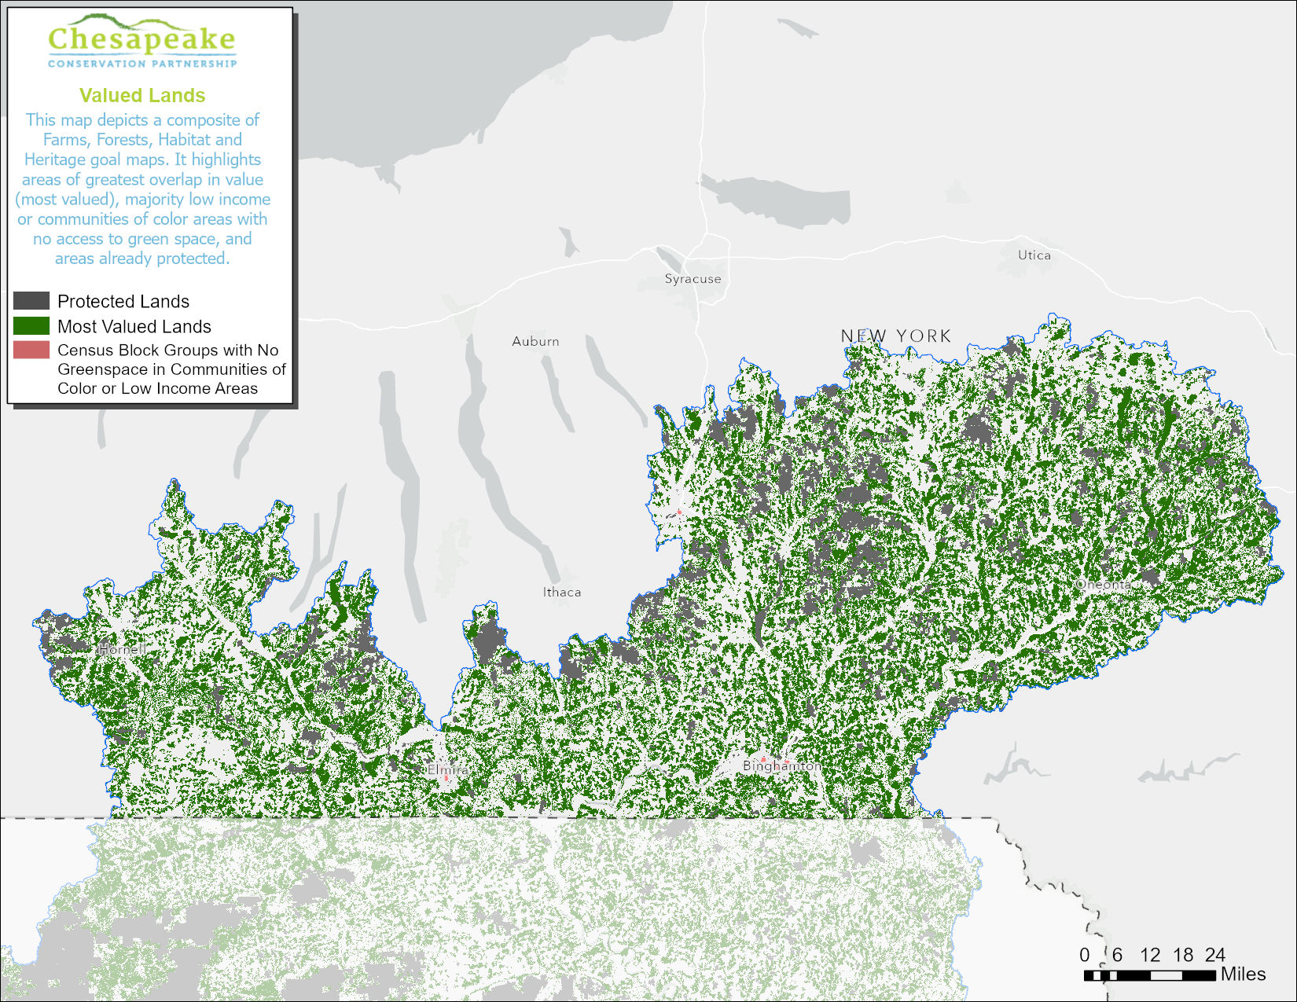
West Virginia

Slide 28
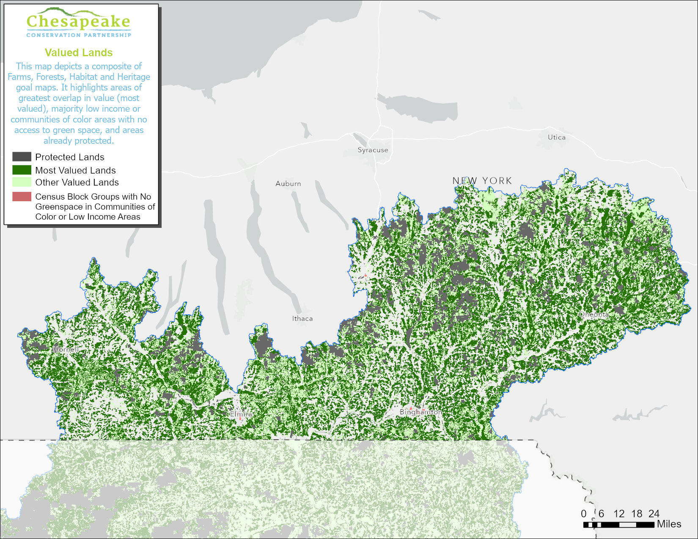
West Virginia

Slide 29
Pennsylvania Progress toward 2-million-acre goal

Slide 30
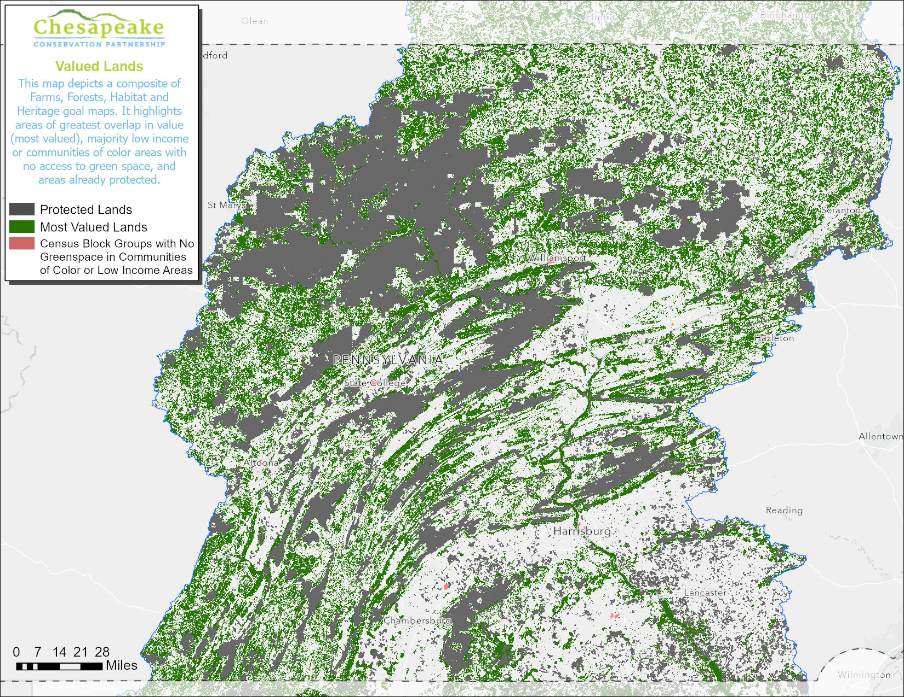
Pennsylvania

Slide 31
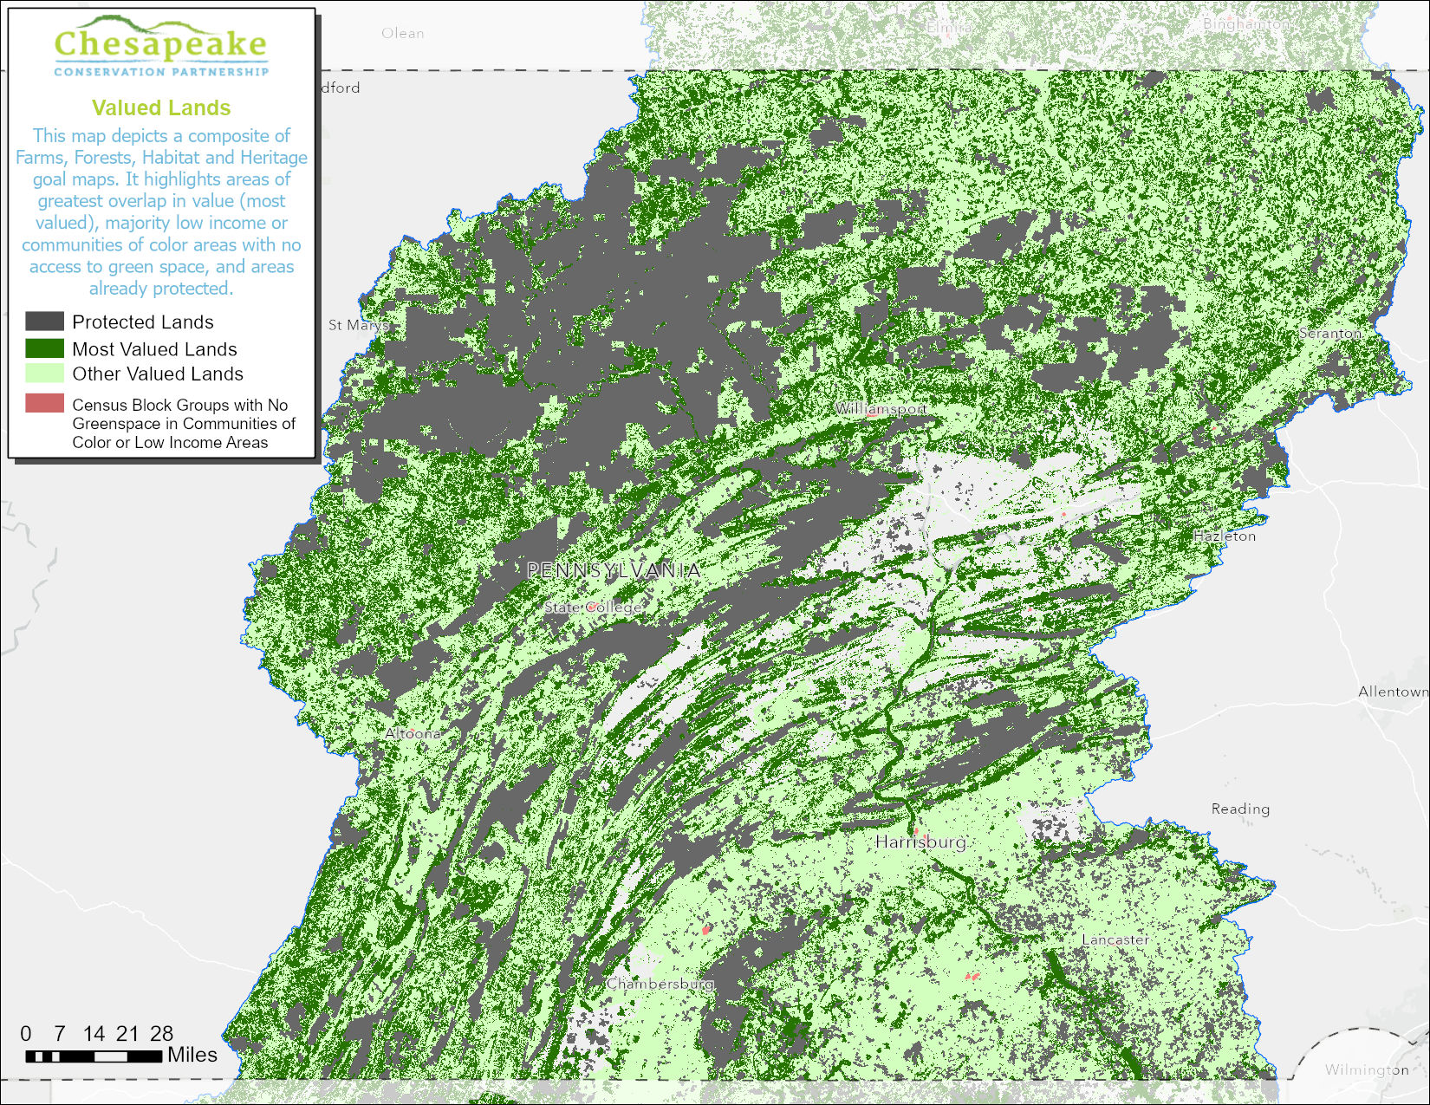
Pennsylvania

Slide 32
Virginia Progress toward 2-million-acre goal

Slide 33
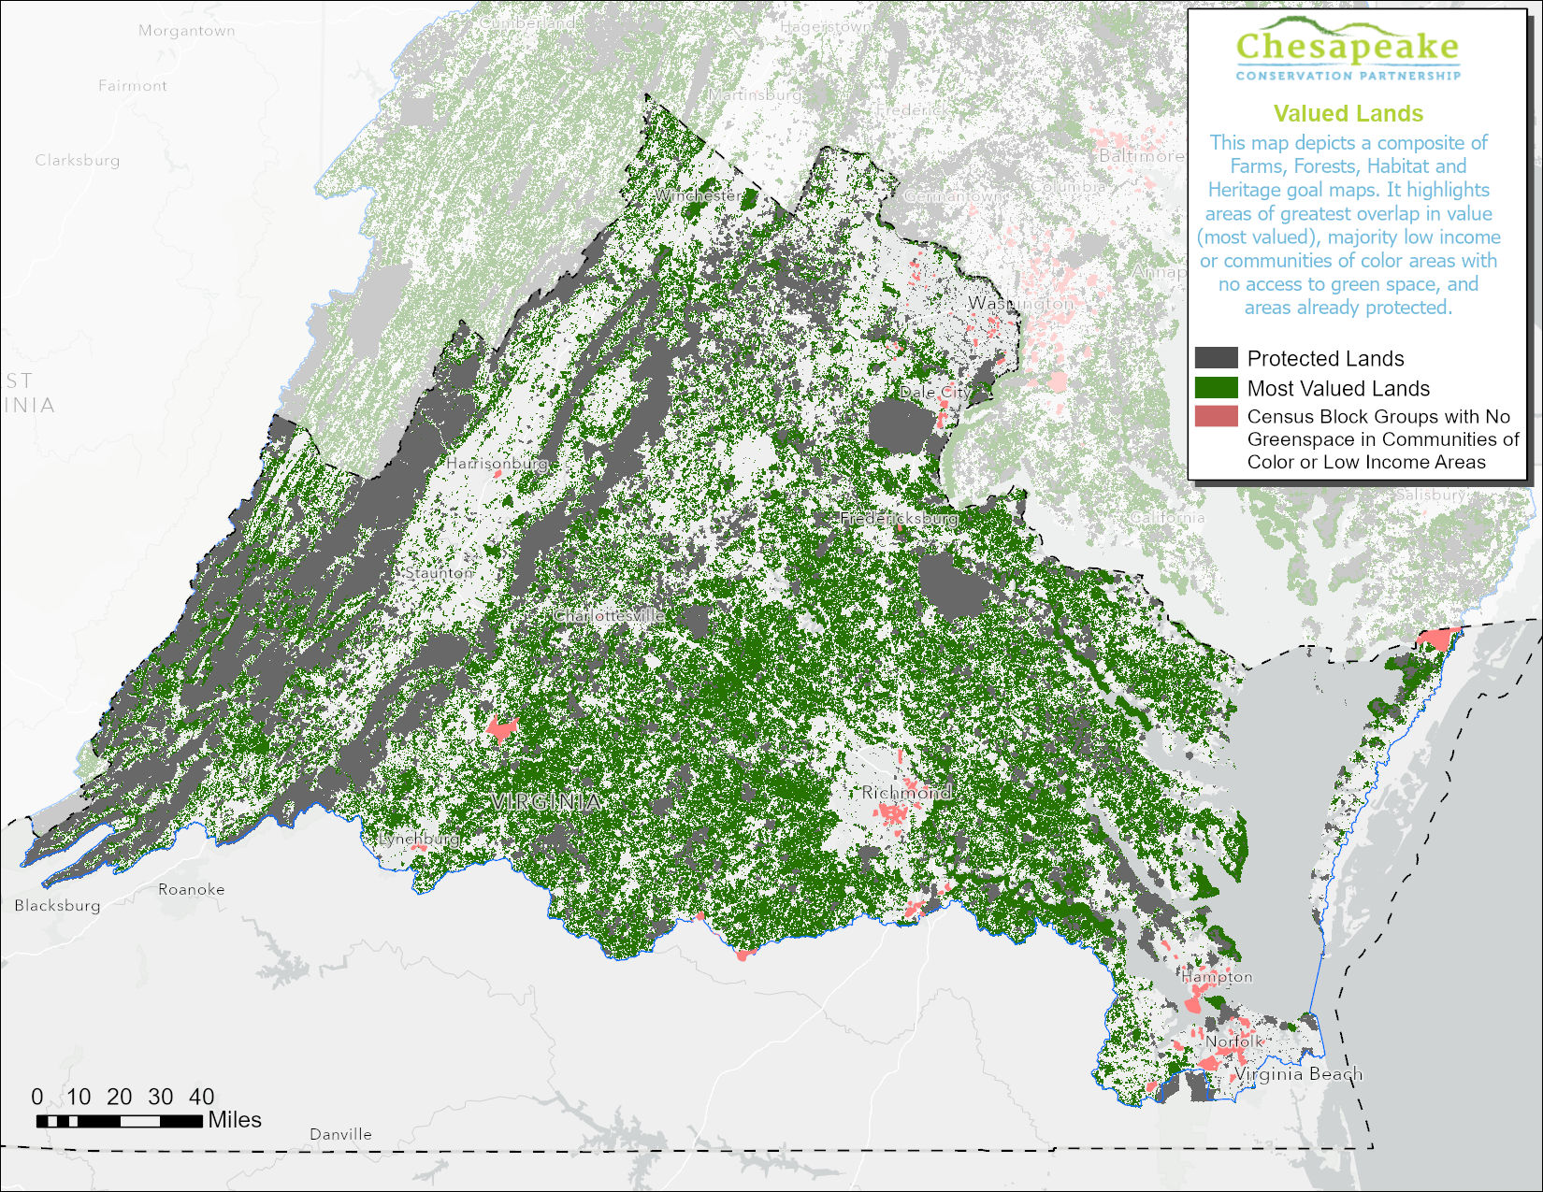
Virginia

Slide 34
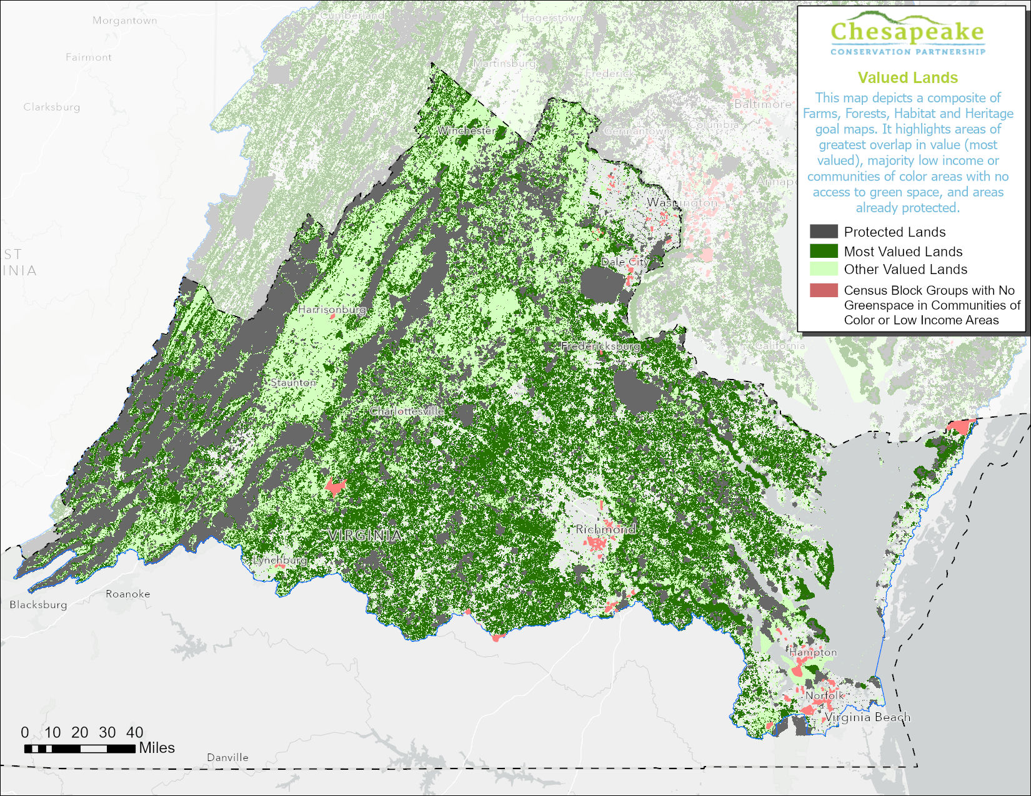
Virginia

Slide 35
West Virginia Progress toward 2-million-acre goal

Slide 36
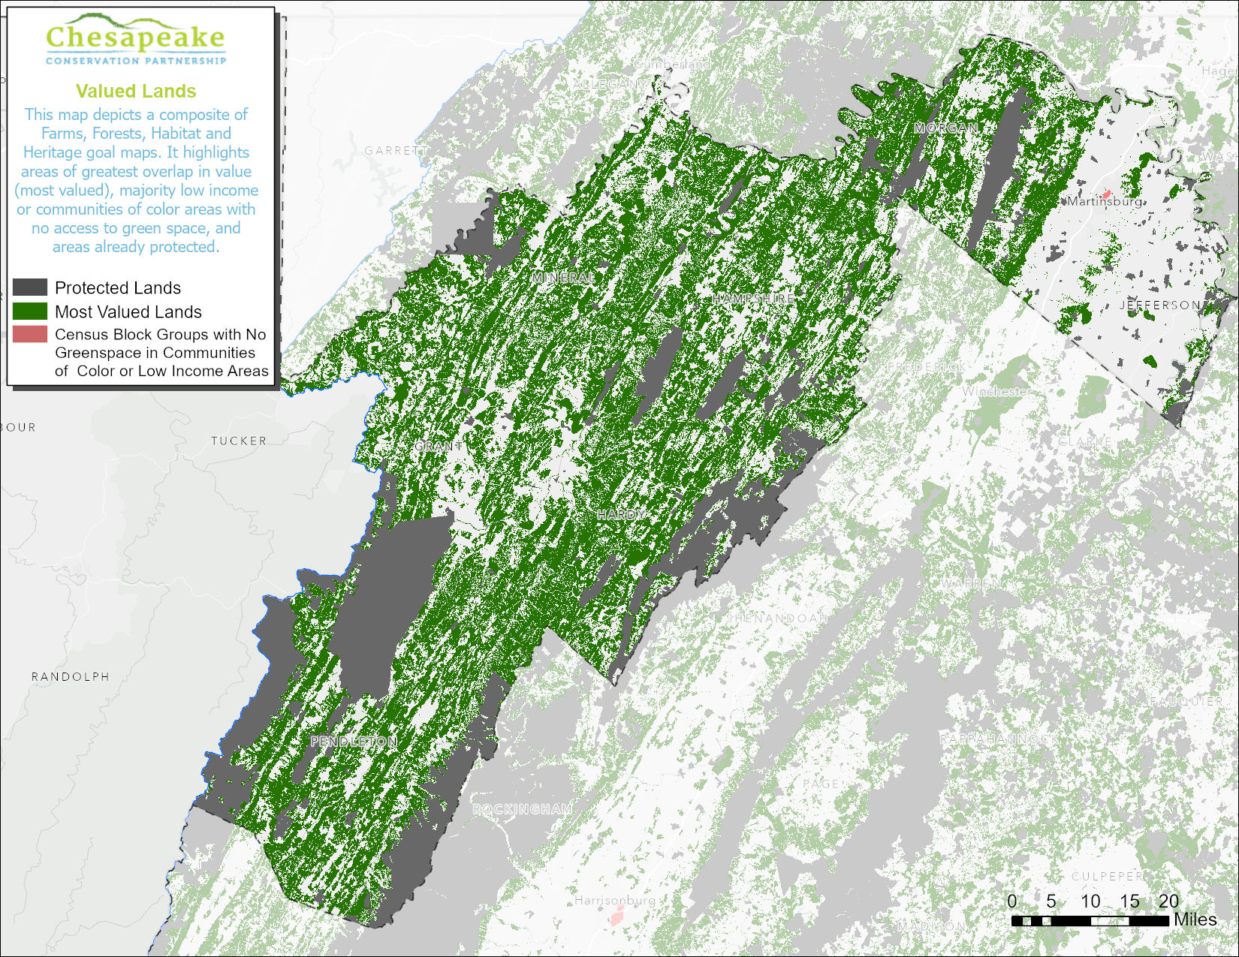
West Virginia

Slide 37
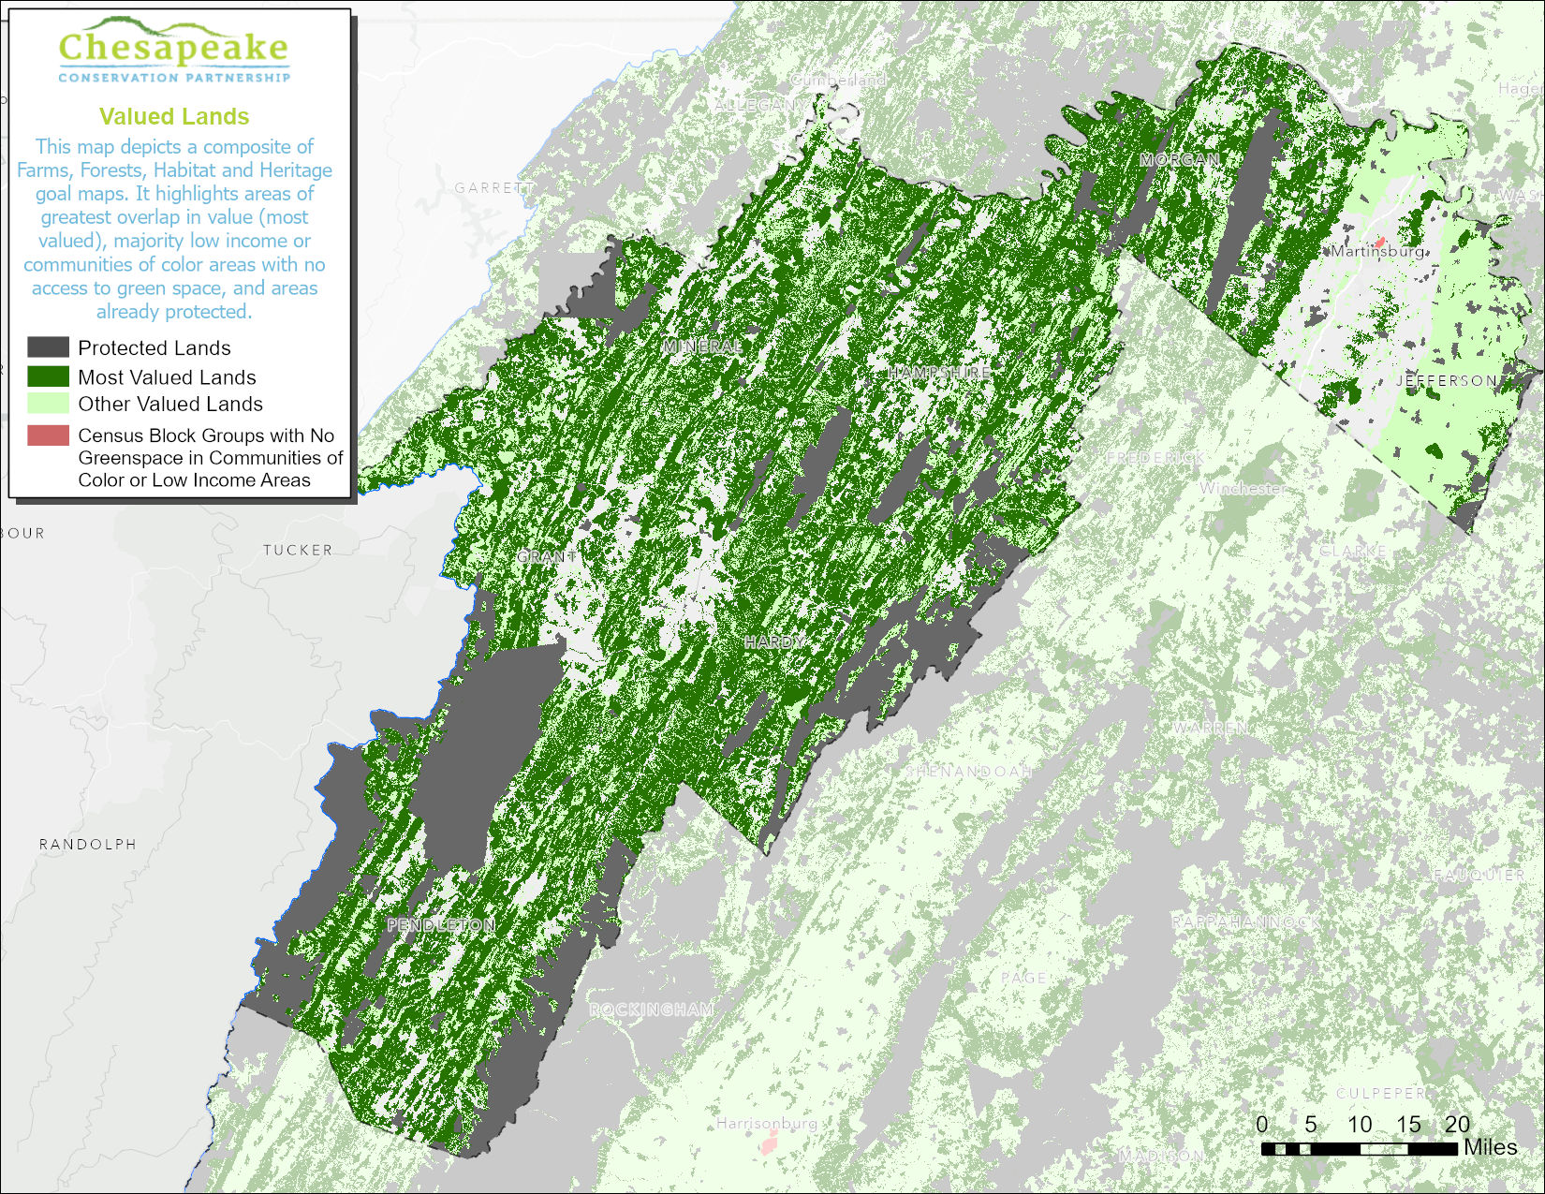
West Virginia

Slide 38
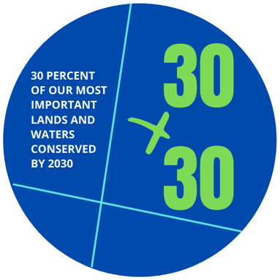
Progress Toward 30% by 2030 Goal
Land Area CBW = 40,745,198* ac.
30% = 12,223,559 (goal) ac.
An additional 4,423,558 ac. needed to meet goal
2022 = 9,317,709
(23% currently protected)
*Recommend updating total land area

Slide 39
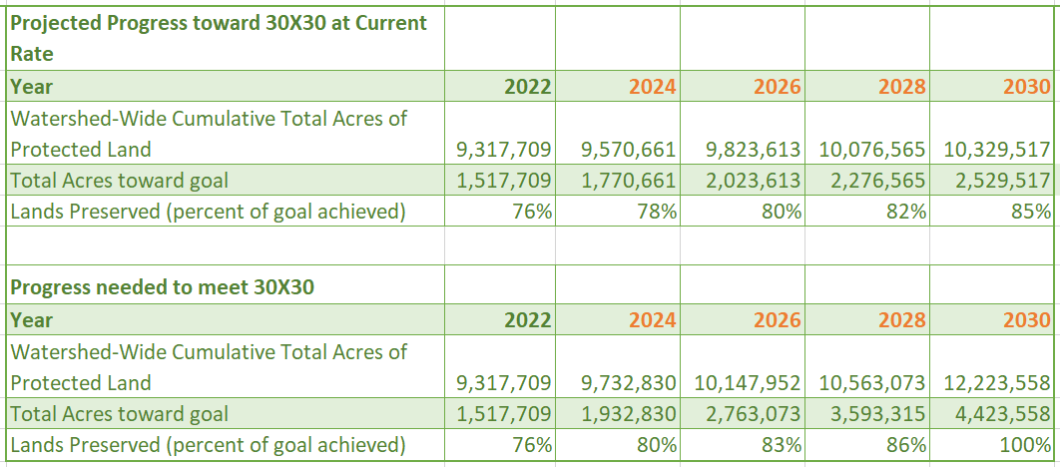
The Rate of conservation needs to increase to meet 2030 30% goals
The rate needs to increase from
126K per year to over
415K per year in order
to reach 30 x 30.
Notes:
7 years to get to 2030

Slide 40
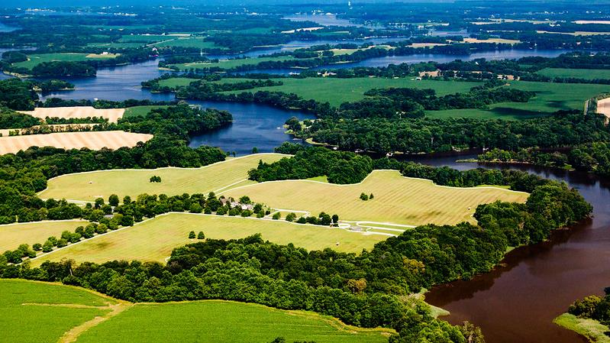
Acknowledgement of Chesapeake Conservancy Staff: Rachel Soobitski, Emily Mills, Jake Leizear, Elliot Kurtz, Steve Storck and Louis Keddell
Renee Thompson, Geographer
Lower-Mississippi Gulf WSC, USGS,
Chesapeake Bay Program, MD
Coordinator Maintain Healthy Watersheds
Goal Implementation Team
rthompso@chesapeakebay.net
rthompson1@usgs.gov
Maps and graphics provided in partnership with:
Photos: Will Parson, Chesapeake Bay Program
Notes:
Rachel Soobitski, Emily Mills, Jake Leizear, Elliot Kurtz, Steve Storck and Louis Keddell

Slide 41
State teams

Slide 42
State teams: The Primary goals
In the Chesapeake Conservation Partnership, states, their partners (including the federal government!) and the many land conserving organizations within them, are the primary units of action. For us to reach our 2025 land conservation goals and make significant progress toward 30x30 as a watershed, states will need to accelerate their land conservation efforts.
The Primary Goal of the 2022 CCP Annual Meeting is for states, working with their CCP partners, to develop initial assertive strategies to accelerate their land conservation efforts.
The additional goal is for participants from each state to identify how the Chesapeake Conservation Partnership can be helpful to their efforts.

Slide 43
Room assignments
STATE | ROOM
Maryland | Gallery
Virginia | 105 I-East
Pennsylvania | 111 I-East
West Virginia | 110 I East

Slide 44
Agenda: Thursday afternoon
Report from Virginia
Chesapeake WILD
Chesapeake Gateways
Next Actions | Next Steps
Closing

Slide 45
Guidance to State Team Facilitators and Convenors
Chesapeake Conservation Partnership Annual Meeting

Slide 46
Our goal is to develop a set of assertive actions that can gain real traction in the states -- that key state players can feasibly COMMIT to, and partners in the state can support. These actions will be stepping stones toward more full-blown strategies that will ultimately lead to 30x30."
NOTE: We are aware that 30x30. as a title of an initiative in your state, may not work. Please do not use valuable time in the room to wordsmith the title now.

Slide 47
As participants develop their initial strategies, the second goal is to identify ways in which the CCP (or other entities) can be helpful and support the state in their efforts.

Slide 48
What are the basics?
State meetings are held on Day Two, November 10th from 9:20 – 11:00. We may extend this time based on what states meeting participants may need to make progress.
Each state will have a convenor and a facilitator.
Each state will have a large state map which shows:
Priority lands from the Chesapeake Atlas.
Priority lands that have been conserved/not conserved
An equity and access layer
Each state will be in its own meeting space.
Facilitators and convenors will receive a list of who is participating in their session.
Facilitators and convenors ARE ENCOURAGED to bring any additional materials (maps, priorities, etc.) that can help support their state’s conversation.

Slide 49
What happens before the state meetings?
Day 1.
The keynote speaker, California Deputy Secretary for Natural Resources will present the state’s 30x30 plan. She will be followed by Brad Rogers, Executive Director of the South Baltimore Gateway Partnership, who will present the Reimagine the Middle Branch project, which is engaging and connecting people, parks, projects & programs in South Baltimore communities. Phil Wenger (Lancaster Land Conservancy) and Lauren Imgrund (Deputy Secretary, DNR, PA) will present a large landscape project on the Susquehanna River.
This will be followed by table and plenary conversation about a 30x30 strategic framework for our watershed.
The goal for the first day is for participants to develop a frame, a mental model, for 30x30 work in our watershed.
Day 2.
On Thursday, Renee Thompson (USGS) will present the updated protected lands data for the watershed and each state.

Slide 50
Notes on the draft agenda
The following agenda is provided as a starting point. Feel free to modify that agenda based on your best judgment of what will work best with your team.
As you think about your agenda, you are encouraged to:
Keep the agenda simple. You will not have enough time for a complicated, multi-stage agenda.
Keep the agenda focused on action and what your state needs to succeed (knowing that important factors are beyond your control)

Slide 51
DRAFT Agenda for state meetings
Start Up (10 minutes)
Intros, agenda review, short briefing on resources, data, and maps that are available.
Initial Exercise. What’s most important in your state’s 30 x 30 plan? (15 minutes)
Small groups of 2-3.
Looking at your state map, where are the most important areas to target for conservation and why? (climate change, devt pressures, greening underserved communities, opportunities, funding etc.) Use stickies.
What are the keys to successfully conserving the lands you have identified?
Plenary debrief. (20 minutes)
Look at map together and discuss. Any emerging consensus?
Develop a shared list of keys to success
Strategy Session. (35 minutes)
How can we best build upon existing efforts in our state?
Action. Where is our state positioned to move toward action on these priorities? Where do we need assistance?
Summarize. Prepare to share with others. (10 minutes)

Slide 52
Role of facilitators and convenors
Convenor
Focus on substance
Share knowledge of state efforts
Help group strategize
Help group focus on next steps and who else to involve. What are the next steps back home?
Share the top 3-4 headlines from your small group work with the larger group.
Facilitator
Focus on process
Help open and guide conversations. Give process instructions.
Support convenor. Check in with convenor.
Help with summarization and next steps. Help provide the convenor with transitions from agenda item to agenda item.
Please use this as guidance, NOT absolute rules. The bottom line is the facilitator and convenor need to be comfortable with each other’s roles and know who is doing what.

Slide 53
Tips for facilitators and convenors
Each state has had many land conversation successes. Help participants stay in a positive, we-can-do-this mindset by using past successes.
Help participants stay out of the weeds and focused on the big picture.
In previous years, many assertive land conservation efforts have been thwarted by the lack of funds. According to some estimates, budget levels are already seven times that of previous years with increased state and federal funding. And more, some say, is expected. The bottleneck can be the lack of capacity to apply for funds or to do deals on the ground. First, focus on this opportunity. Second, if your state has a bottleneck, you should have a strategy to address that challenge.
Keep everyone in the conversation. You will have a set of participants who have varying levels of knowledge about conservation in your state. New ideas often come from those who bring a different perspectives, actively seek different perspectives.
FINALIZE your agenda. Put the agenda on a flipchart or on a PowerPoint slide. (all rooms can project from a computer.)

Slide 54
Your Todo’s
FINALIZE your agenda. Put the agenda on a flipchart or on a PowerPoint slide. (all rooms can project from a computer.) See Slide 8 for a sample agenda.
Review who is attending your session and think about who can significantly contribute and what they can contribute. Give them a heads up on Day 1. (e.g., John, I know you . . . , I’m hoping you can share an overview of ______ in the session tomorrow.
Check out your room on Day 1 and think through how you want to arrange the room. If you need assistance, please let Bill or Aurelia know.
Touch base with your partner convenor or facilitator and check signals with each other.
State | Convenor | Facilitator
MD | Cheryl Wise | Kristen Saunders or Britt Slattery
PA | Lauren Imgrund | Aurelia Gracia
VA | Brett Glymph | Genevieve LaRouche
WV | John Rowe | Mike Slattery

Slide 55
Questions? Concerns?
Bill Potapchuk is available before and during the annual meeting to help you think through your state meeting strategy. Feel free to contact him at any time.
Bill Potapchuk
bill@communitytools.net
703-431-9943 cell
https://calendly.com/cbi/30-minute-meeting (to set up an appointment)

