Slide 1
Protected Lands Indicator
John Wolf, USGS
Aurelia Gracia, NPS
October 12th, 2023
CBP Management Board Meeting

Slide 2
Protected Lands
“Protected lands” means lands permanently protected from development, whether by purchase or donation, through a perpetual conservation or open space easement or fee ownership for their cultural, historical, ecological, or agricultural value.

Slide 3
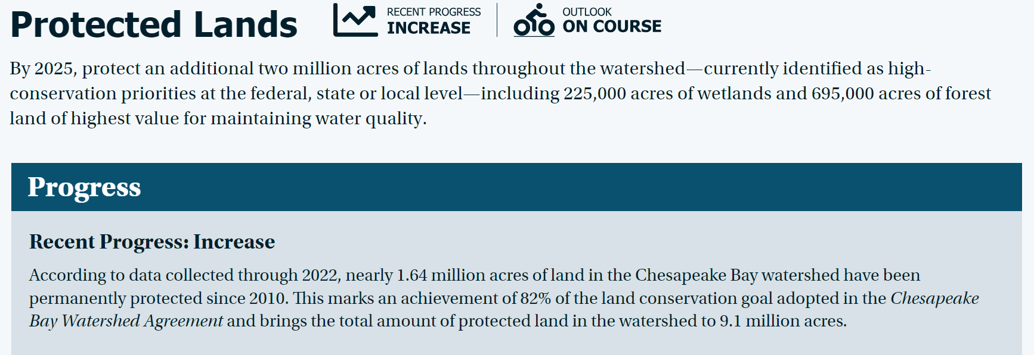

Slide 4
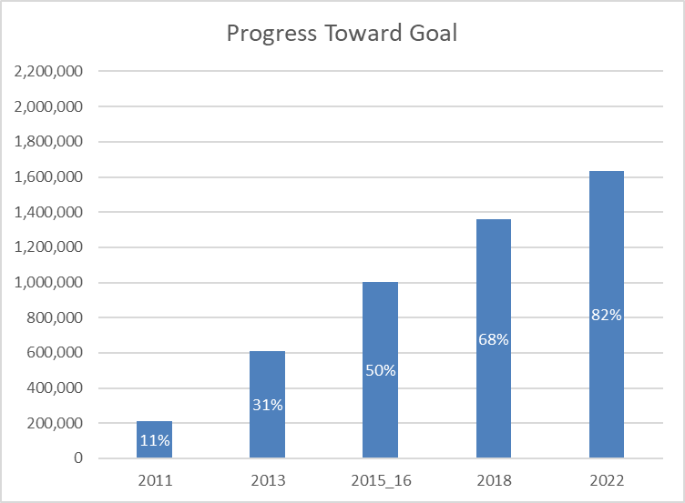
Protected Lands Progress towards 2M Acre Goal
2010 Baseline:
7,474,811 acres
2022 Progress:
9,109,278 acres
Acres Protected since 2010
1,634,467
Remaining:
365,533 acres
Goal

Slide 5
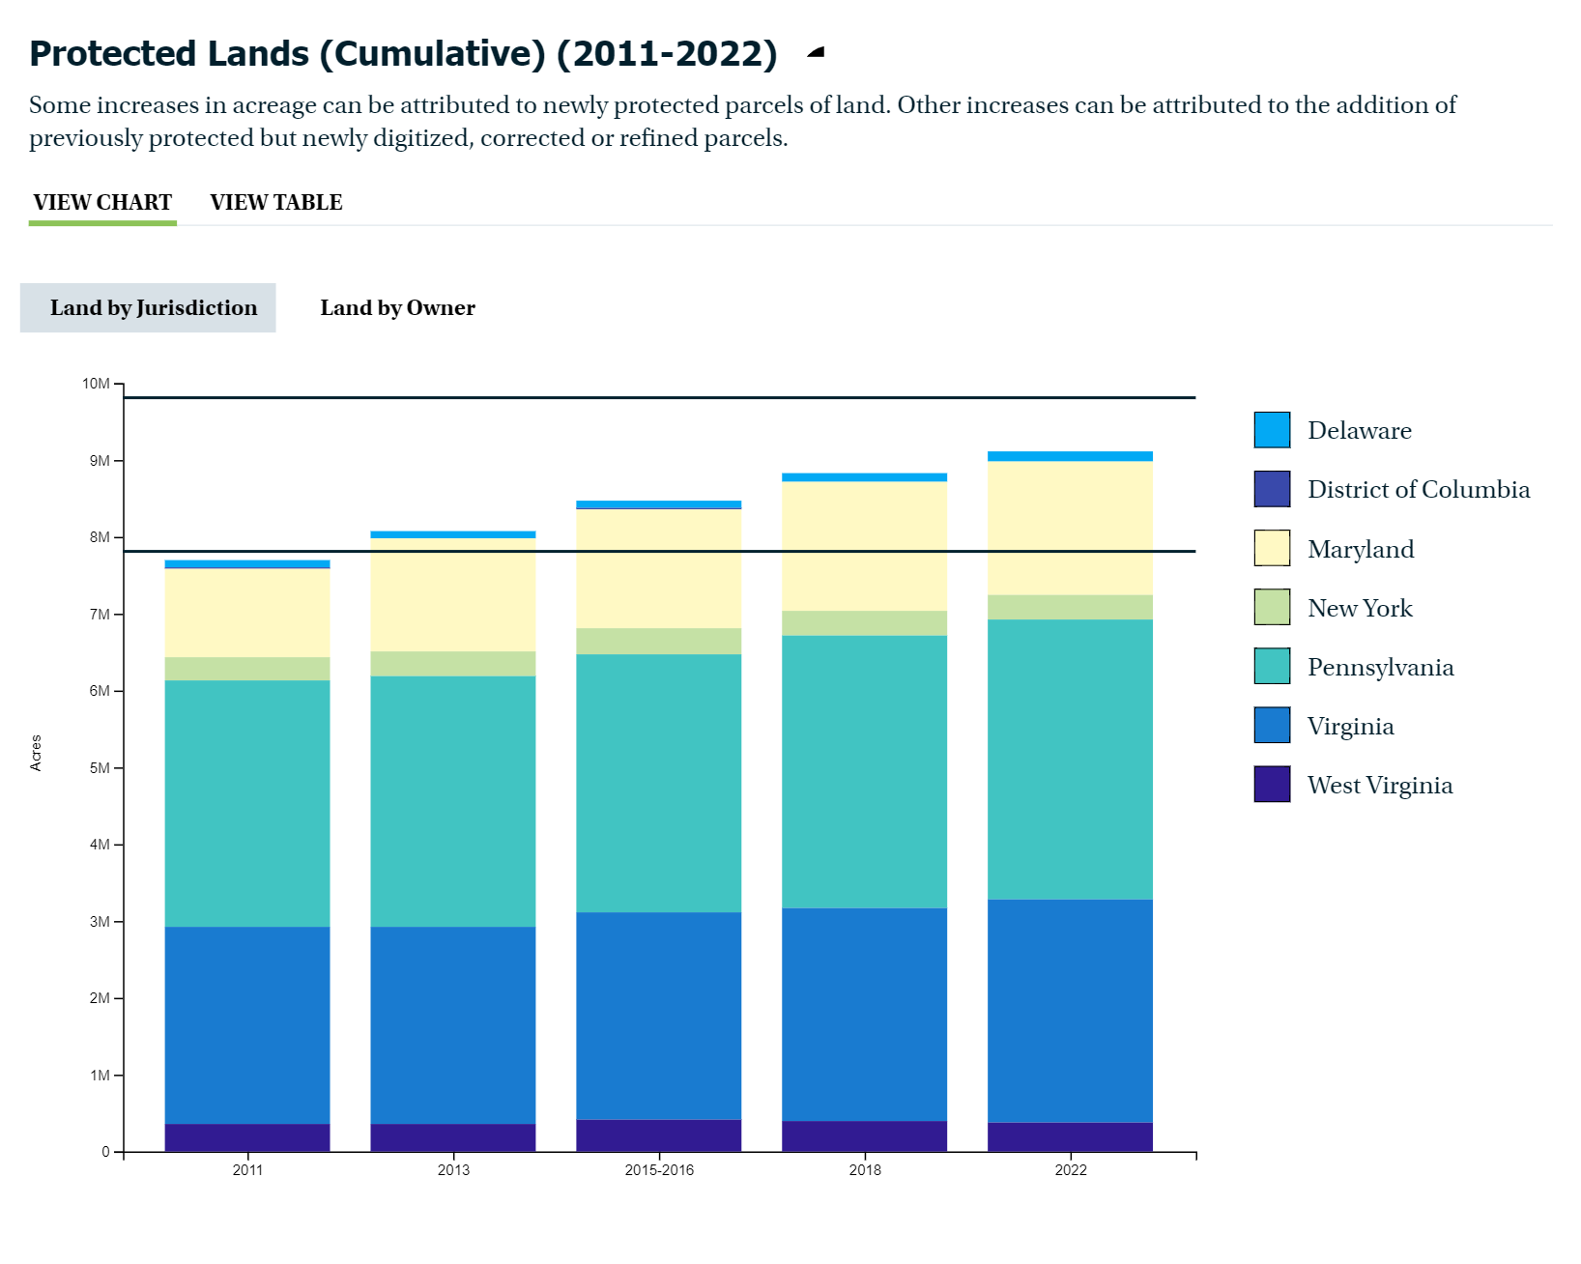

Slide 6
Protected Lands by Land Use: Acres
*Based on 2022 Protected Lands data and 2017/18 High-resolution Land Use/Cover data.

Slide 7
Changes with Tracking Land Protection
Change over time can reflect...
Land protection accomplishments
e.g., State purchases x acres for conservation purposes
Changes in data sources
e.g., a new data resource is identified that is more comprehensive than what has been used in the past
Changes in methods or definitions
e.g., PAD-US changes criteria for what is considered "protected"

Slide 8
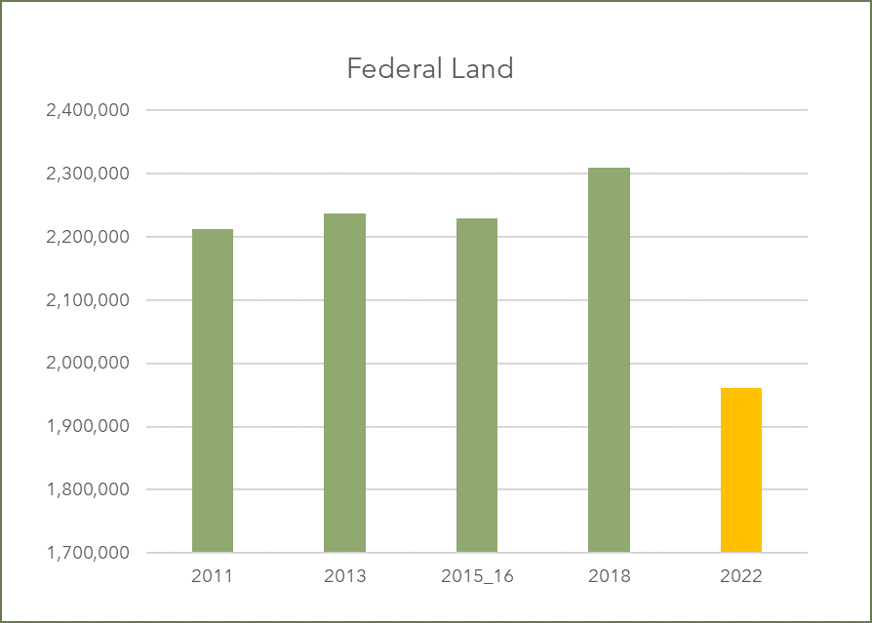
Federally Protected Lands and Improvements in Data
Improvements to the Federal land extent based on changes to PAD-US
Removal of DoD lands not permanently protected or managed for conservation purposes
Removal of inholdings
Mapping federal ownership or protection as opposed to proclamation boundaries
Removal of reservoirs

Slide 9
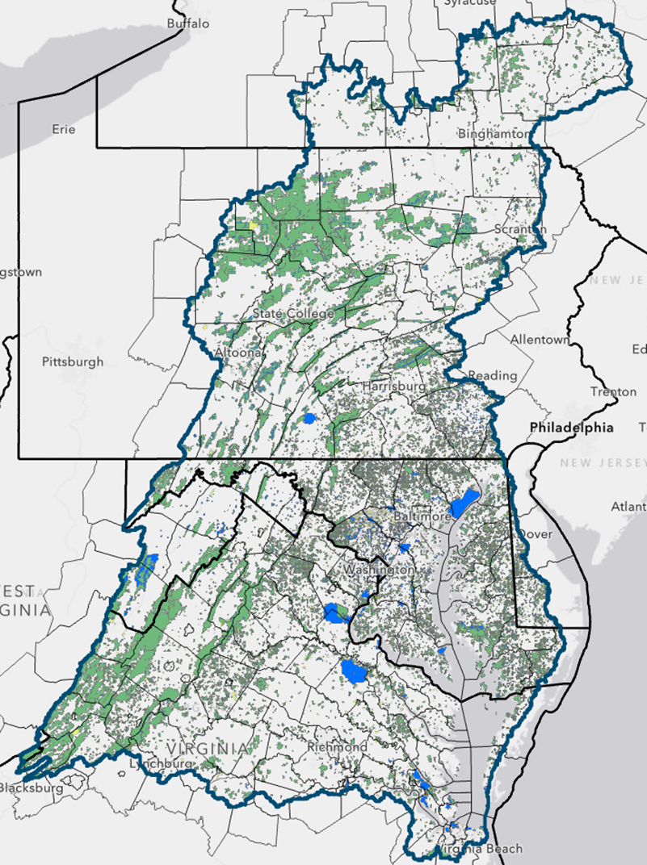
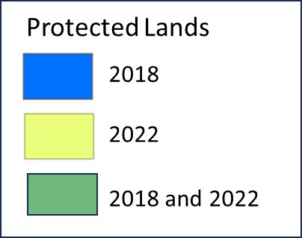
Comparing 2018 and 2022

Slide 10
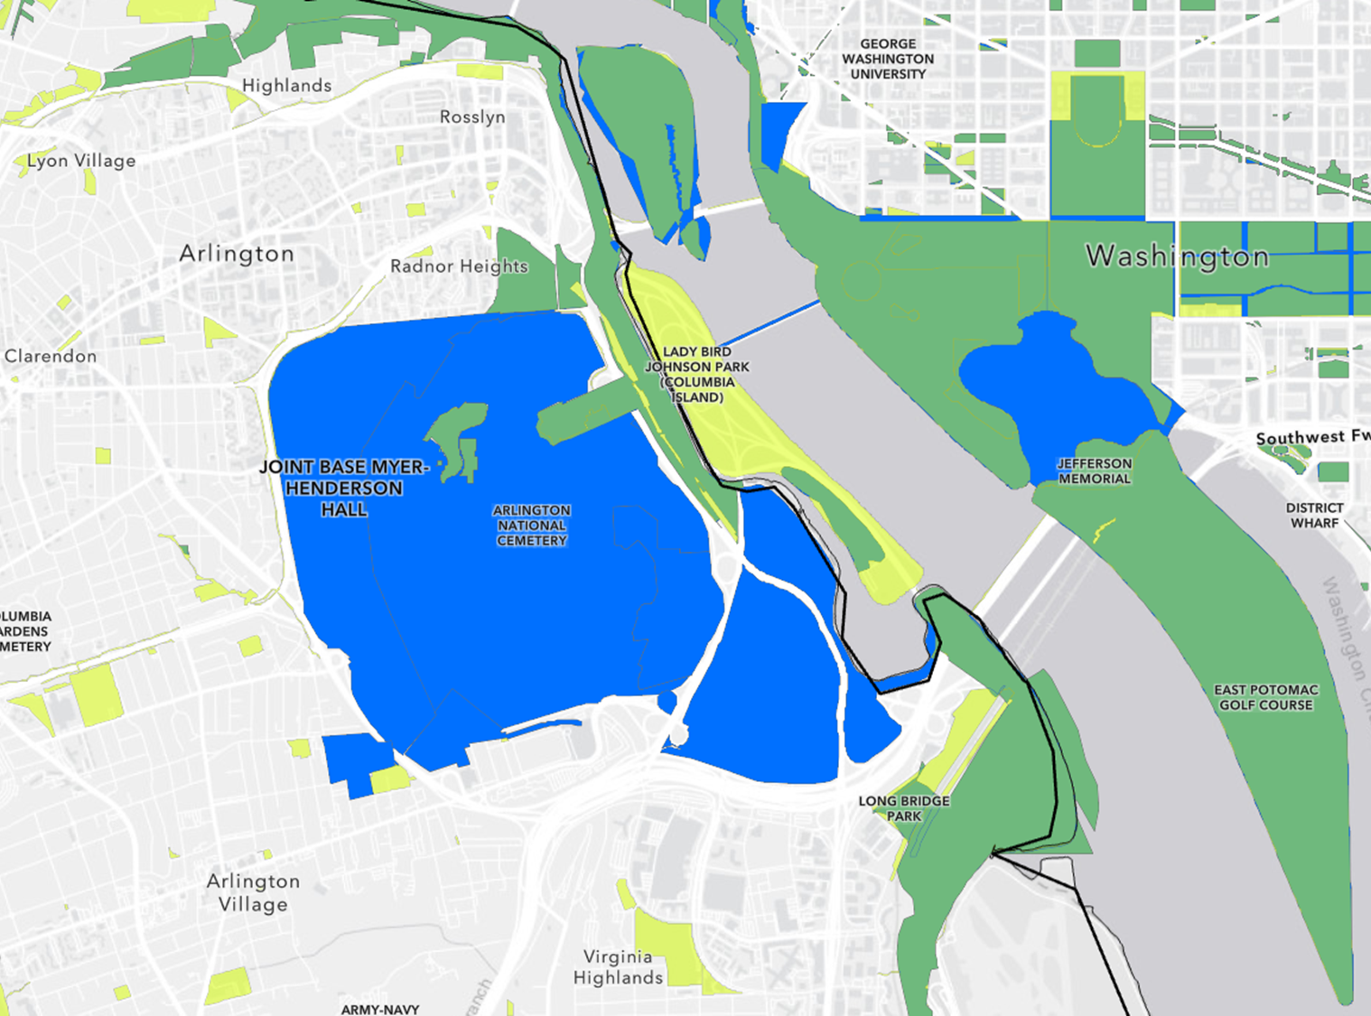
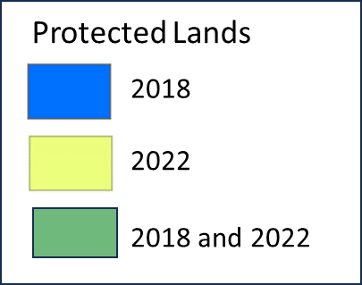
Arlington
/ D.C.

Slide 11
Applied Analysis and Adjustments
Identify Federal lands that, in 2022, are no longer counted as per PAD-US
For 2018 and earlier years, remove those same federal lands so they are treated consistently throughout entire period of record

Slide 12
Post-Retroactive Adjustment
Goal

Slide 13
2022 Update – Lessons Learned
What is working well with current method?
Continue to improve methodology for more accurate accounting.
What are some current obstacles?
Increased accuracy can lead to counterintuitive results
Attempts to streamline information collection process only partly successful
Perceived duplication of effort with PAD-US
Potential to address obstacles or improve efficiency
GIS Community of Practice to address consistency and reporting needs
State data stewards take ownership of state land protection reporting
Strategic plan to address improvements and integration, with input from jurisdictions, Community of Practice and PLWG
Potential for improved efficiency in reporting through PAD-US collaboration
Rely on existing published workflows for easements, other protected lands

Slide 14
Actions for Future Progress
CCP Annual Meeting (Now)
Feedback from CCP Annual Meeting will help inform actions and ideas for the PLWG
Creation of a new Logic and Action Plan (Winter)
Identify actions and priorities to further advance land protection
Creation of a new GIS Community of Practice (Winter)
Contacts pulled from the PAD-US System and contacts suggested by State representatives and the Chesapeake Conservation Partnership

